Slide 1
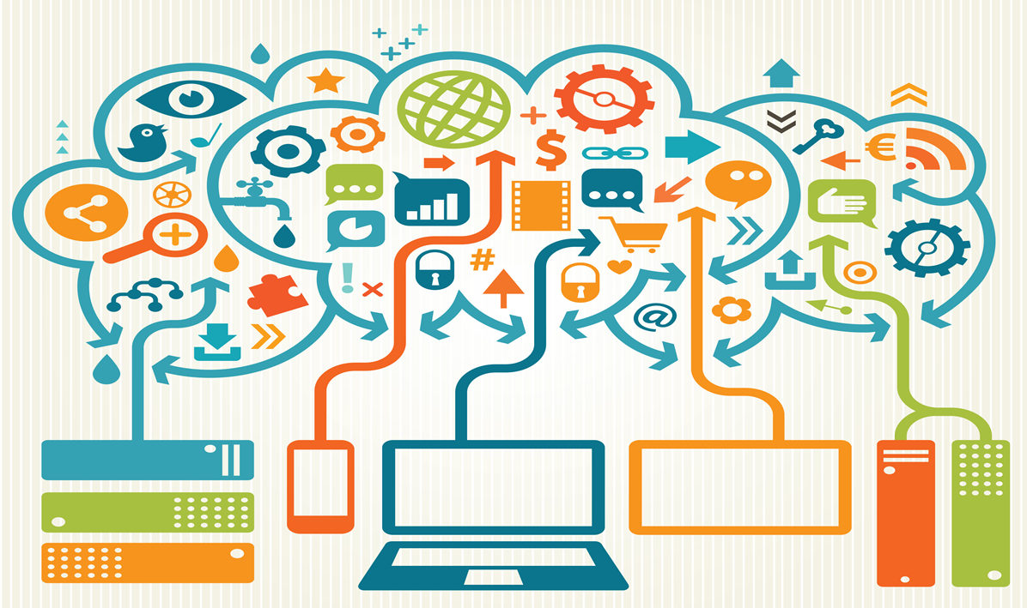

Big Data
by Arun Bisht

Slide 2
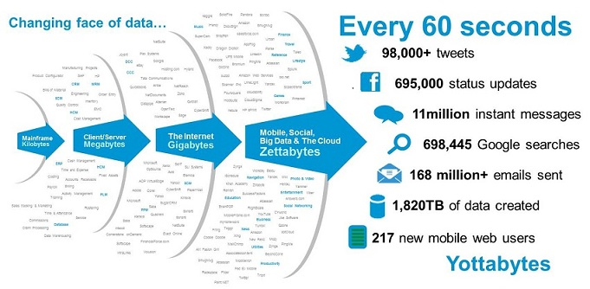

Slide 3
Big Data Definition
No single standard definition…
“Big Data” is data whose scale, diversity, and complexity require new architecture, techniques, algorithms, and analytics to manage it and extract value and hidden knowledge from it…

Slide 4
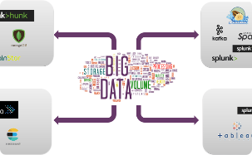
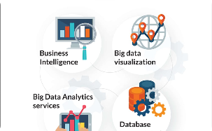
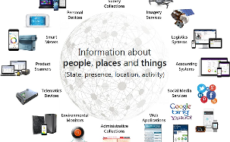
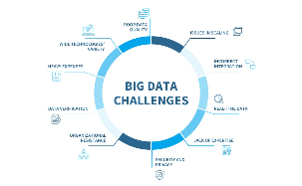
What is Big Data?
Data Storage
Data Analytics
Data Sources
Challenges
Big data refers to the volume, velocity, and variety of data. It is stored in distributed file systems like HDFS, NoSQL databases, and cloud storage systems.
Big data is analyzed using tools like Hadoop, Spark, and Pig. It involves predictive modeling, data mining, and machine learning.
Big data comes from various sources such as social media, sensors, log files, and transactional data.
Big data management faces challenges like security and privacy, data quality, and scalability.

Slide 5
Types of Big Data
Structured Data
Unstructured Data
Semi-Structured Data
Data that can be easily organized into a table or schema such as data in relational databases.
Data that doesn’t follow a specific format like videos, images, and social media posts.
Data that has some structure but does not fit easily into tables such as XML, JSON, and log files.

Slide 6
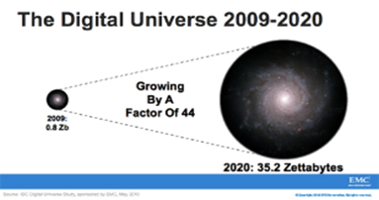

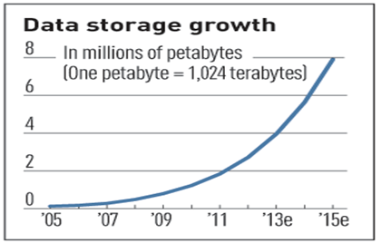
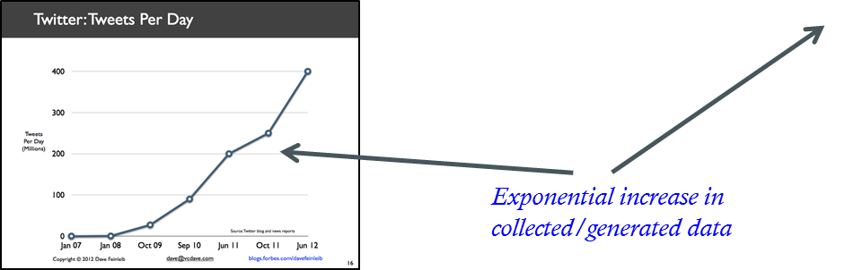
Characteristics of Big Data: 1-Scale (Volume)
Data Volume
  44x increase from 2009 2020
  From 0.8 zettabytes to 35zb
Data volume is increasing exponentially

Slide 7
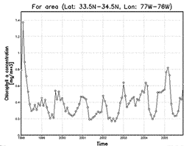
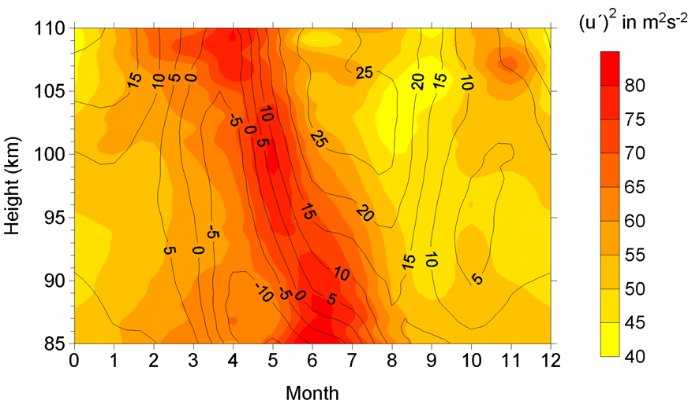
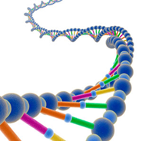
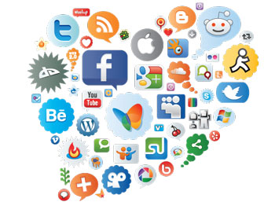

Characteristics of Big Data: Complexity (Varity)
Various formats, types, and structures
Text, numerical, images, audio, video, sequences, time series, social media data, multi-dim arrays, etc…
Static data vs. streaming data
A single application can be generating/collecting many types of data
To extract knowledge➔ all these types of data need to linked together

Slide 8
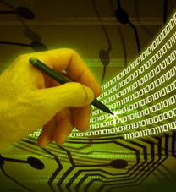
Characteristics of Big Data: Speed (Velocity)
Data is begin generated fast and need to be processed fast
Online Data Analytics
Late decisions missing opportunities
Examples
  E-Promotions: Based on your current location, your purchase history, what you like send promotions right now for store next to you
  Healthcare monitoring: sensors monitoring your activities and body any abnormal measurements require immediate reaction

Slide 9
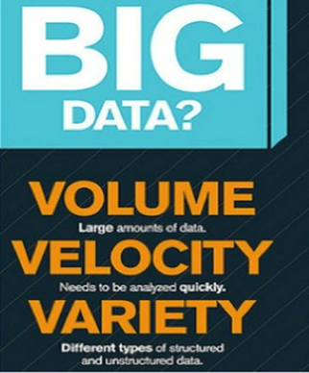
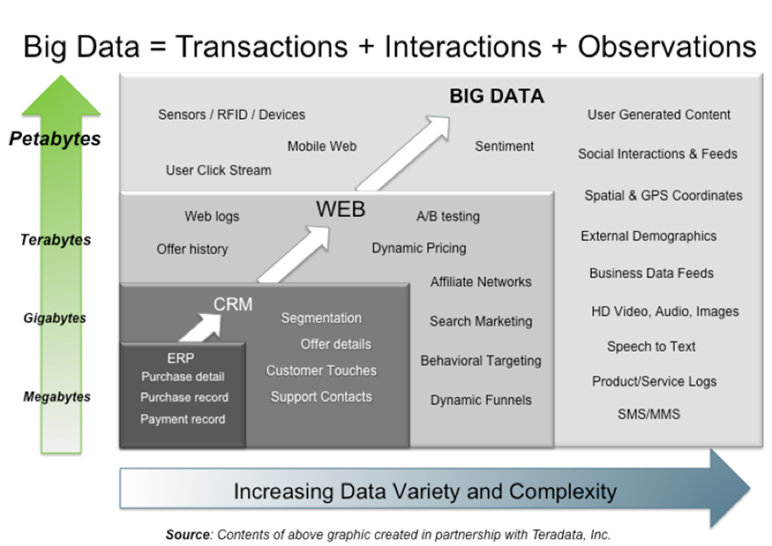
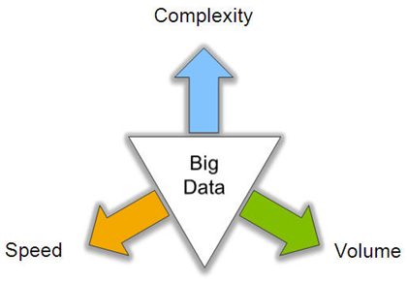
Big Data: 3V’s

Slide 10
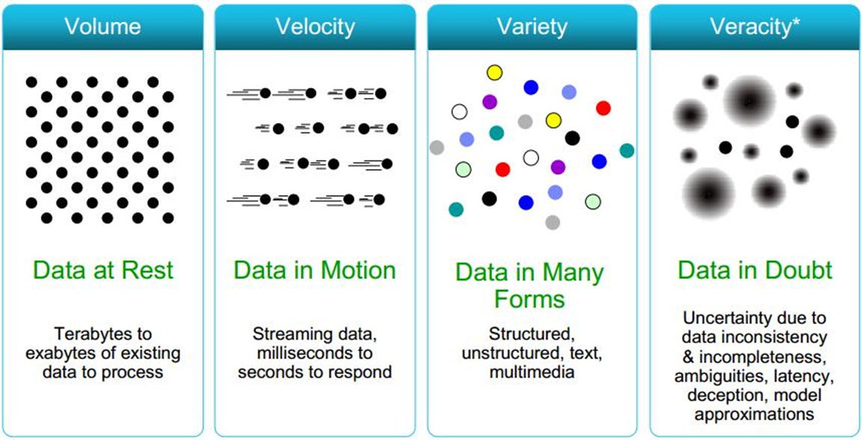
Some Make it 4V’s

Slide 11
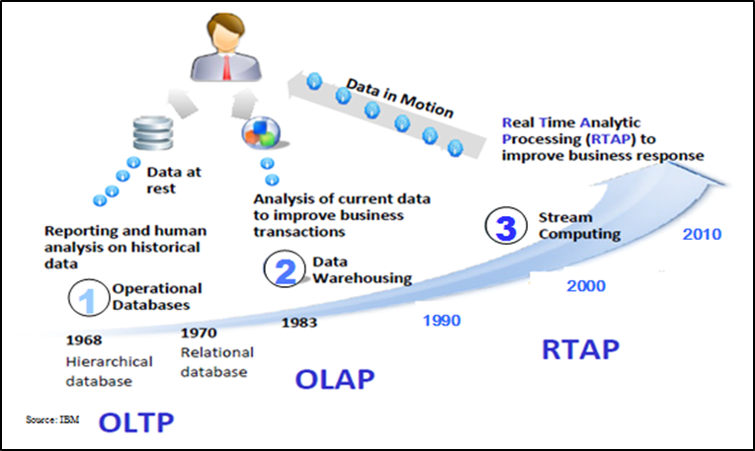
Harnessing Big Data
OLTP: Online Transaction Processing (DBMSs)
OLAP: Online Analytical Processing (Data Warehousing)
RTAP: Real-Time Analytics Processing (Big Data Architecture & technology)

Slide 12

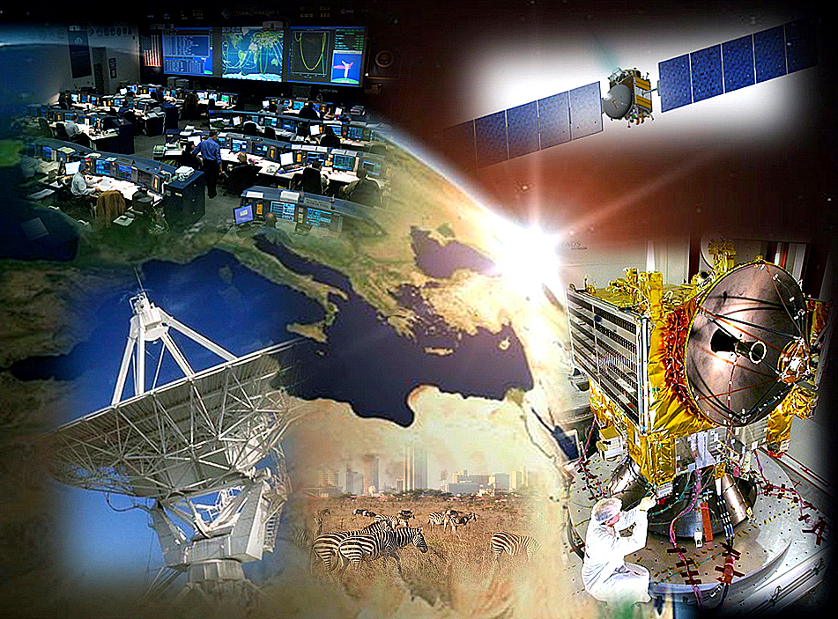
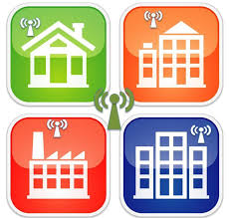
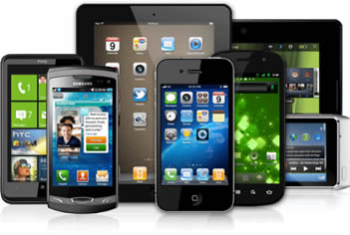
Who’s Generating Big Data ?
Social media and networks
(all of us are generating data)
Scientific instruments
(collecting all sorts of data)
Mobile devices
(tracking all objects all the time)
Sensor technology and networks
(measuring all kinds of data)
The progress and innovation is no longer hindered by the ability to collect data
But, by the ability to manage, analyze, summarize, visualize, and discover knowledge from the collected data in a timely manner and in a scalable fashion

Slide 13
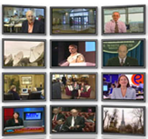


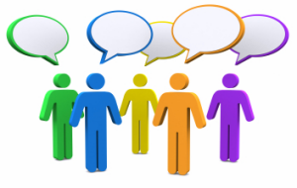
The Model Has Changed…
The Model of Generating/Consuming Data has Changed
Old Model: Few companies are generating data, all others are consuming data
New Model: all of us are generating data, and all of us are consuming data

Slide 14
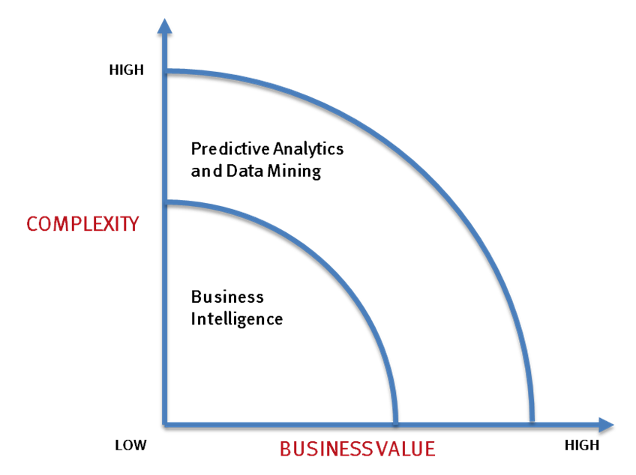
What’s driving Big Data ?
- Optimizations and predictive analytics
- Complex statistical analysis
- All types of data, and many sources
- Very large datasets
- More of a real-time
- Ad-hoc querying and reporting
- Data mining techniques
- Structured data, typical sources
- Small to mid-size datasets

Slide 15
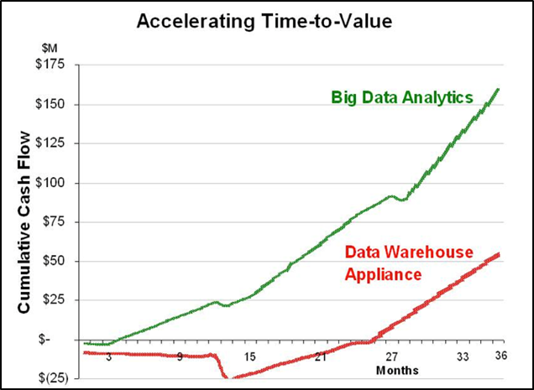
Value of Big Data Analytics
Big data is more real-time in nature than traditional DW applications
Traditional DW architectures (e.g. Exadata, Teradata) are not well-suited for big data apps
Shared nothing, massively parallel processing, scale out architectures are well-suited for big data apps

Slide 16
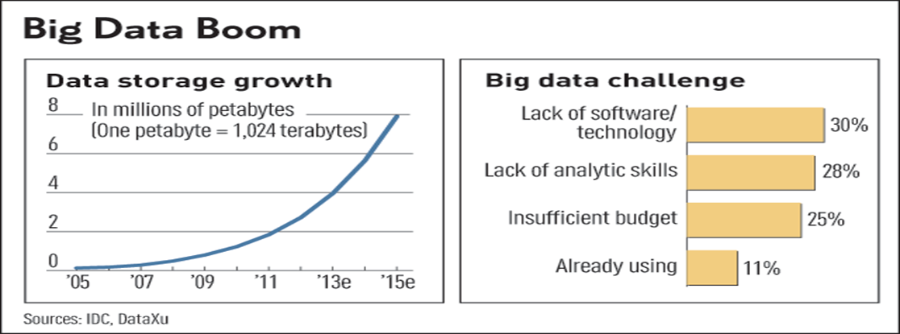
Challenges in Handling Big Data
The Bottleneck is in technology
  New architecture, algorithms, techniques are needed
Also in technical skills
  Experts in using the new technology and dealing with big data

Slide 17
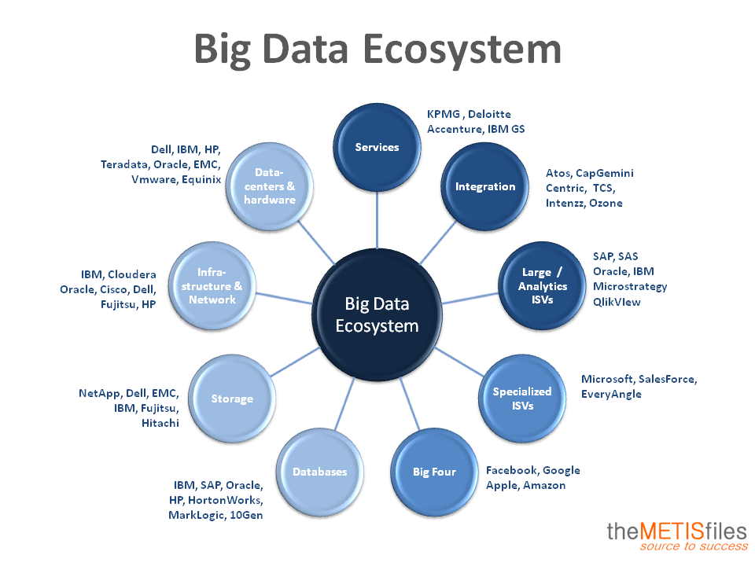

Slide 18

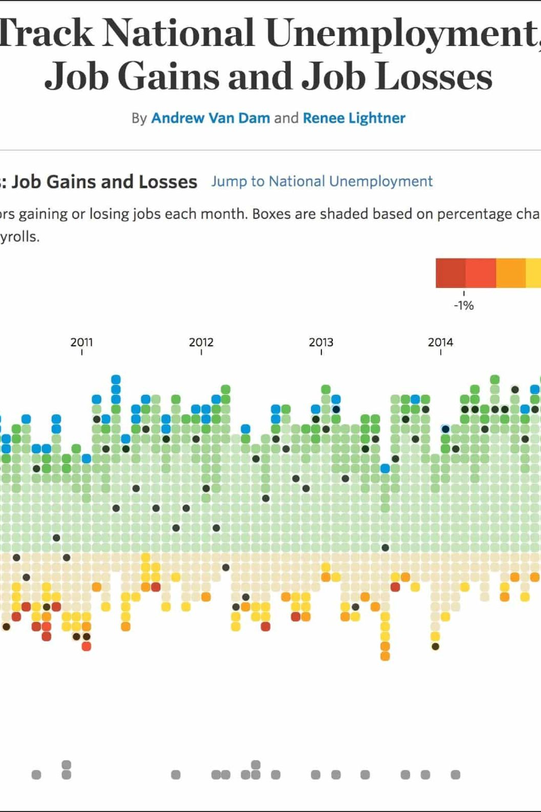
Introduction to Big Data and Visualization
Big data is a collection of large and complex data sets that traditional data processing methods cannot handle. Learn more about its types, usage, visualization, and its use case in e-Governance.

Slide 19
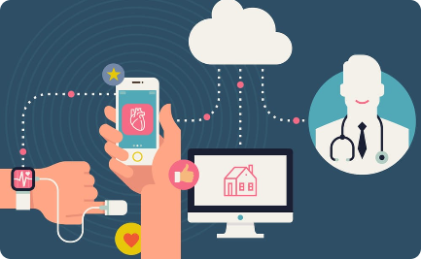
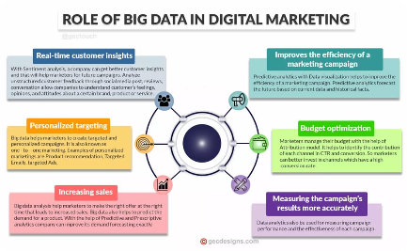
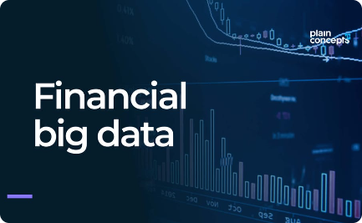
Usage of Big Data
Healthcare
Marketing
Finance
Big data is used for disease prediction, personalized medicine, and identifying high-risk patients.
Big data is used for customer profiling, market segmentation, and product recommendations.
Big data is used for fraud detection, risk management, and algorithmic trading.

Slide 20
Visualization Techniques of Big Data
Network Diagrams
Network diagrams show relationships between data points. They are useful for analyzing social networks and related entities.
1
2
3
Heat Maps
Chord Diagrams
Heat maps show data density and patterns using colors. They are useful for identifying patterns in large data sets.
Chord diagrams visualize data flow or data migration patterns. They are useful for visualizing how data moves between systems.

Slide 21

Case Study: Big Data in e-Governance
Big data is transforming e-Governance by improving decision-making processes and enhancing citizen services.
In India, the GST system, Passport Seva Kendra, CoWIN and Swachh Bharat Mission (SBM) are some examples of successful implementation of big data.

Slide 22

Benefits of Big Data in e-Governance
1
Transparency
2
Efficiency
Big data provides transparency in government processes, which helps build trust and accountability.
Big data helps government agencies to operate efficiently by automating processes, reducing time, and costs.
3
Better Decision-making
Big data helps government officials to make data-driven decisions, which leads to better outcomes.

Slide 23
Conclusion
Big Data is a game-changer in the way businesses and governments operate. Its impact on e-Governance is transforming citizens' lives across the world by generating insights that help improve public services.

Slide 24
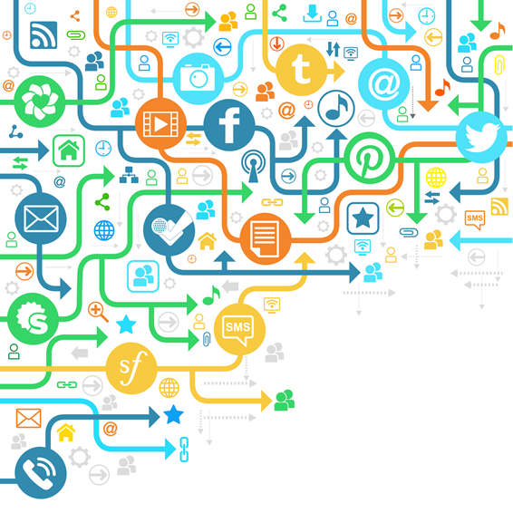
Thank You

