Slide 1
UNDERSTANDING BLOCKCHAIN
Manoj Pande
UAoA Nainital

Slide 2

OBJECTIVES
To Describe what a Blockchain is.
To Explain how a Blockchain works
To identify the problems a Blockchain solves.

Slide 3

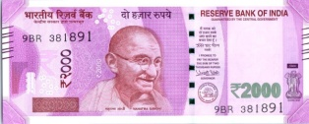
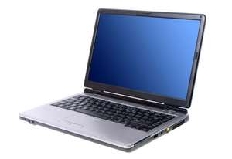
THE INTERNET OF INFORMATION
WE MAKE COPIES OF DOCUMENTS,VIDEOS,MUSIC AND SEND THEM TO EVERYONE, CAN WE DO THE SAME WITH MONEY?

Slide 4
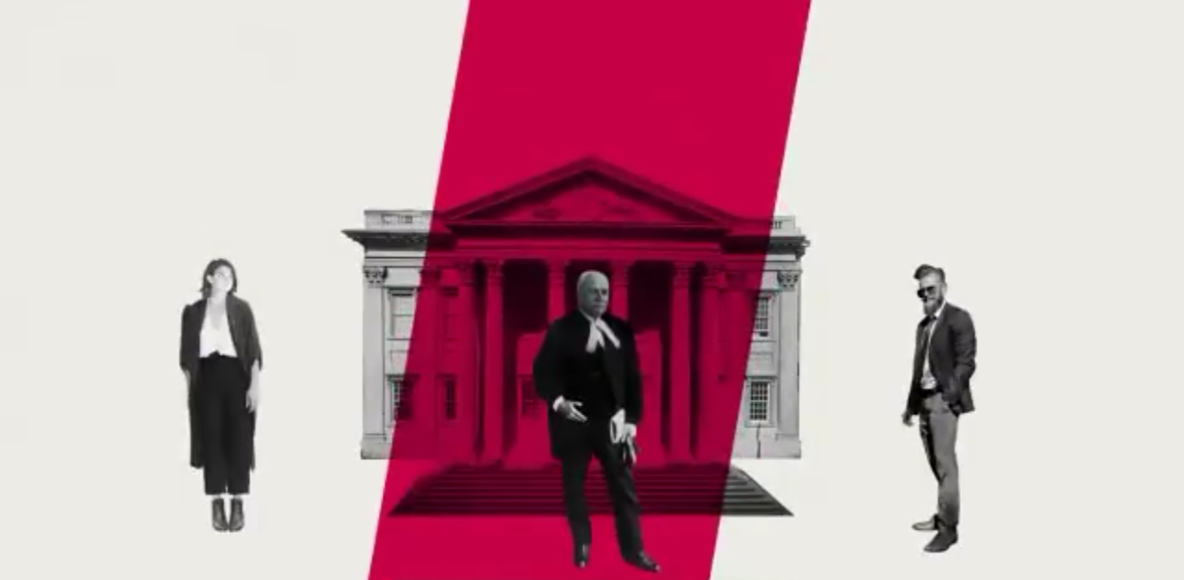
Money Transactions require and intermediary which costs time and money.
A bank Transaction is nothing but and entry in the ledger.

Slide 5
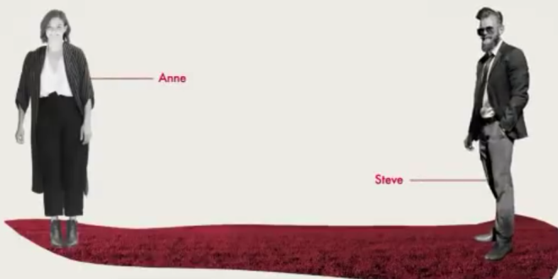
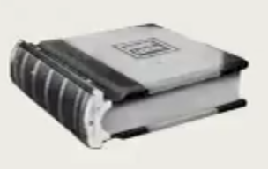
WHO OWNS THE PIECE OF LAND?
2018 | Manoj Pande S/O Lalit Mohan Pande
2010 | ------------------
2000 | ------------------
1980 | Harpreet Singh S/O Gurpreet Singh
1930 | ------------------
1880 | ------------------
1850 | Ram Singh S/O Bahadur Singh
Land Records/ Khatauni Register
A NOTARY, A TIME STAMP
How can Trust be lost?

Slide 6

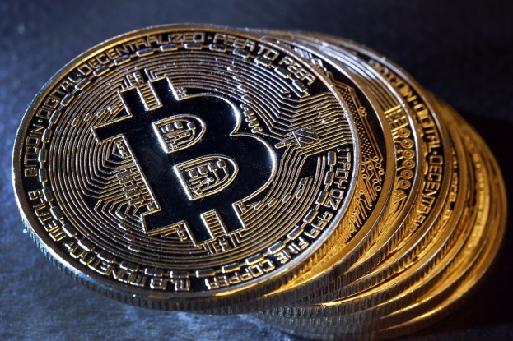
A Group of Researchers intended to TIME STAMP Documents so that it becomes impossible to back date them almost like a NOTARY
1991
Santoshi Nakamoto Made Bitcoin
2009

Slide 7
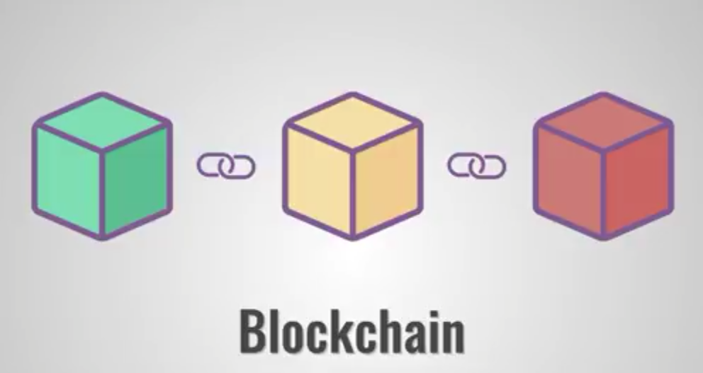
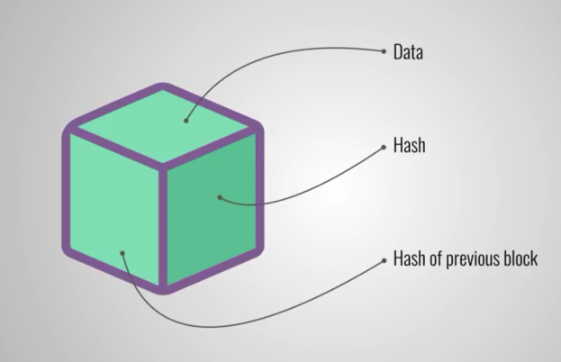
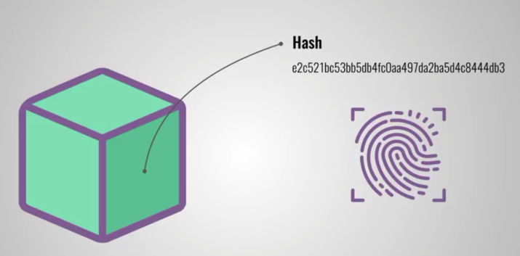
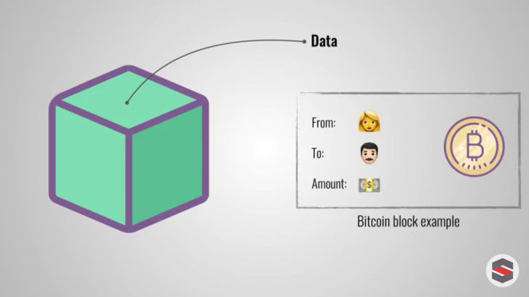
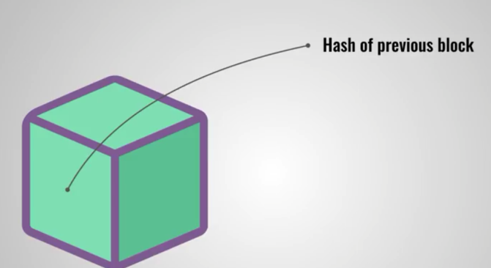
HOW DOES A BLOCKCHAIN WORK?

Slide 8

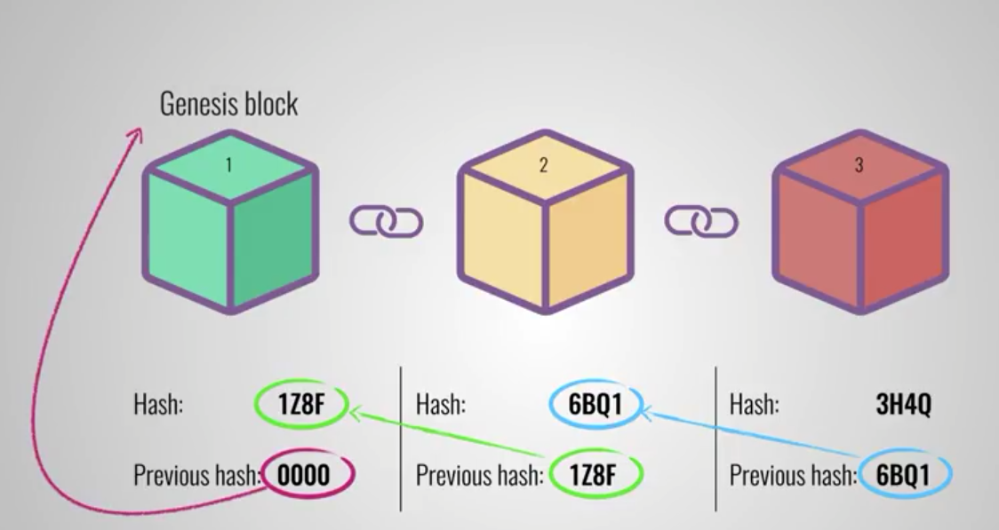
HOW DOES A BLOCKCHAIN WORK?

Slide 9
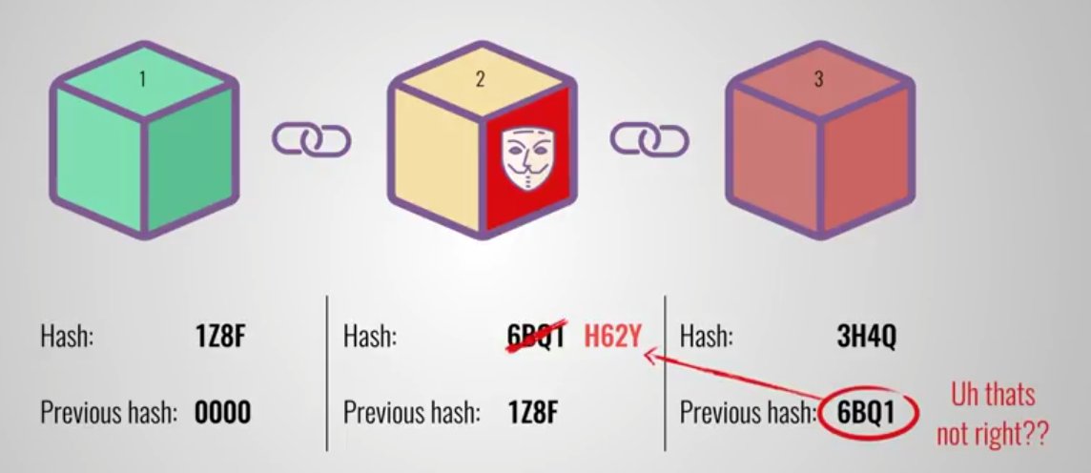
HOW DOES A BLOCKCHAIN WORK?
But Modern Computers with immense computing powers can make changes in the whole chain!!!!!!

Slide 10
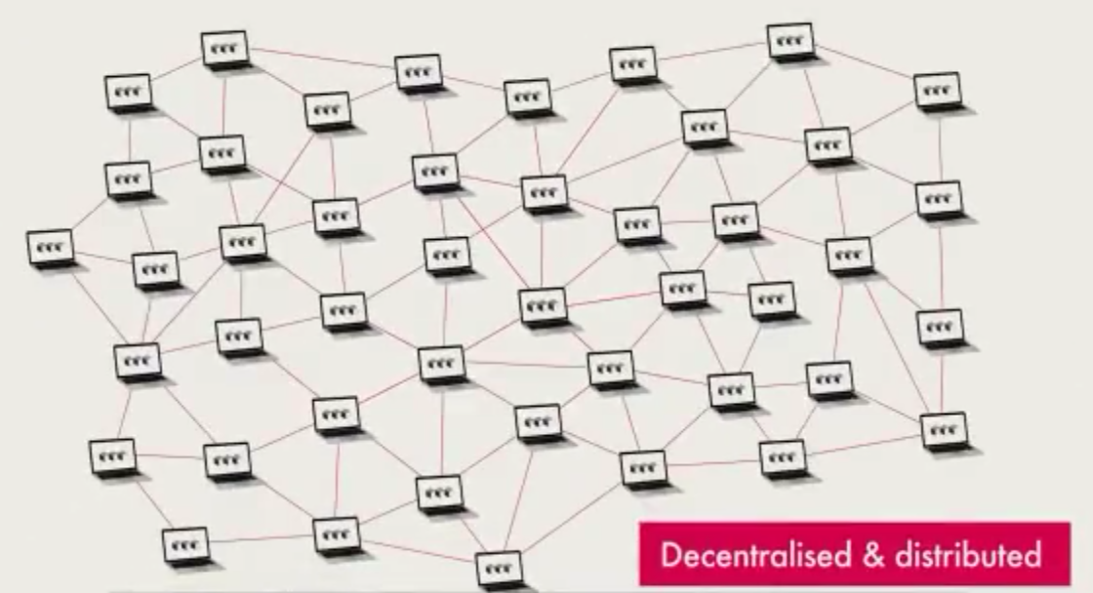
HOW DOES A BLOCKCHAIN WORK?
TRUST IN THE DATA

Slide 11
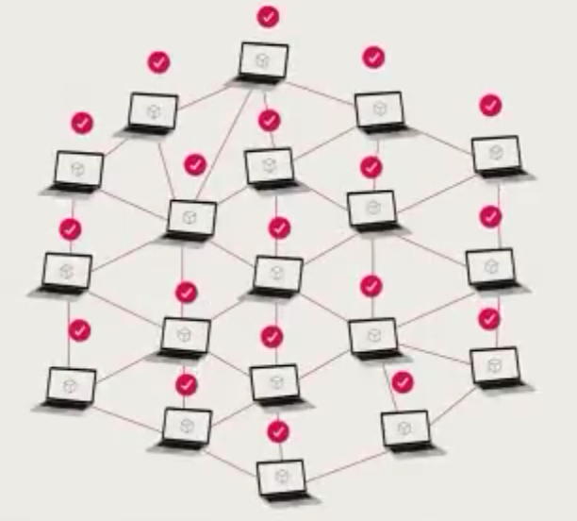
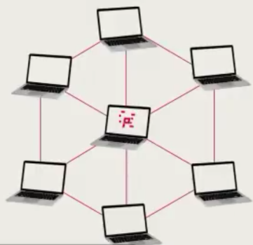
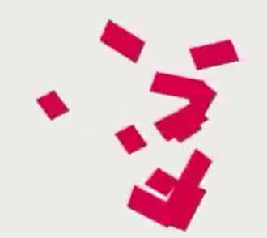
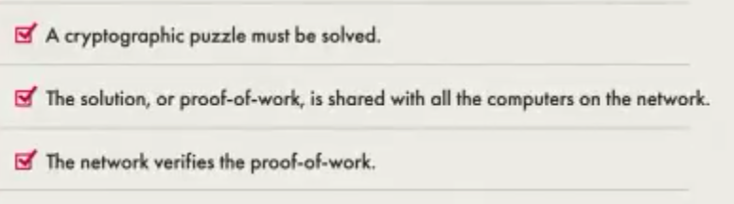
HOW DOES A BLOCKCHAIN WORK?
Share it with Other Computer
Network Verifies the Proof of Work
Cryptographic Puzzle to be solved

Slide 12
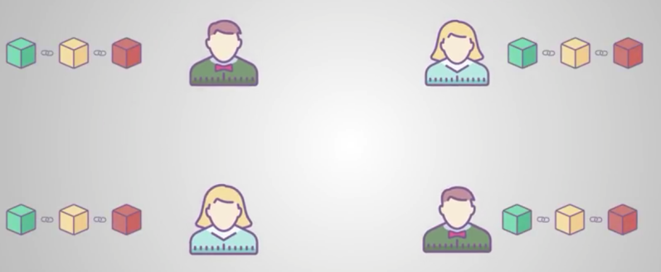
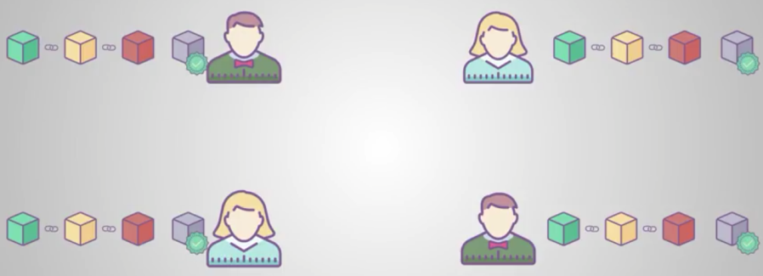
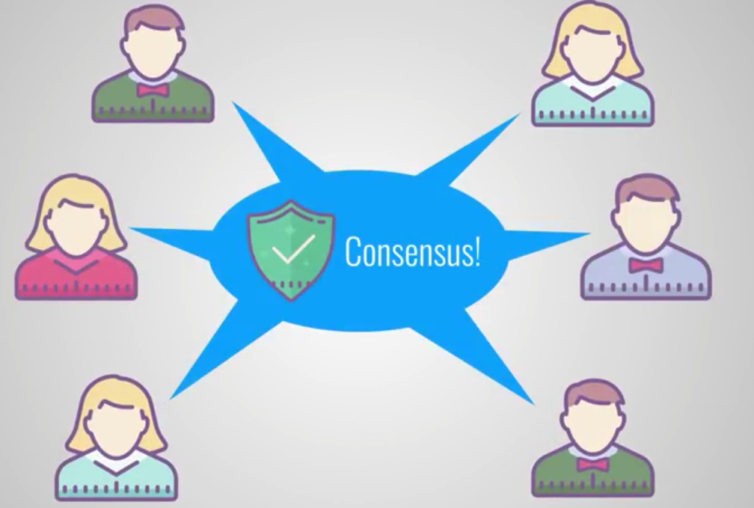
HOW DOES A BLOCKCHAIN WORK?

Slide 13
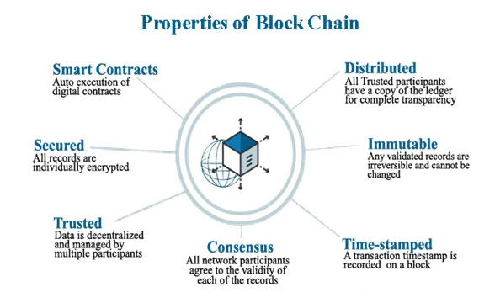

Slide 14
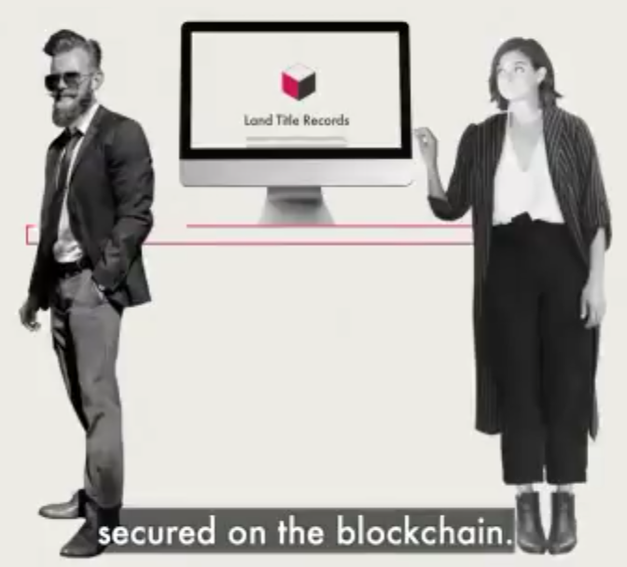
Three Reasons the Blockchain would bring revolution
Reason 1: The manner in which Data is Kept
Reason 2:Trust in the Data
Reason 3: No Need for Intermediaries

Slide 15
Questions?
What are three information that a Block Contains?
In which Areas Blockchain Technology can be used?
What is Proof of Work and what are its three steps?
Give reasons why BlockChain would revolutionize the way information is kept or transacted.

Slide 16
Any Questions?

Slide 17
THANK YOU

